Slide 1
Electronic band structure of CrN and GdN from x-ray spectroscopy
Andrew Preston
andrew@preston.co.nz

Slide 2
Boston University
James McNulty, Bo Chen, Jude Laverock
Alex DeMasi, Sang Wan Cho
Kevin Smith

Slide 3
Collaborators
Louis Piper
SUNY Binghamton
Alexei Fedorov, Jeng-Lung Chen, Jinghua Guo
Advanced Light Source
Walter Lambrecht
Case Western Reserve
Jim Partridge, Steve Durbin, Ben Ruck
MacDiarmid Institute, NZ

Slide 4
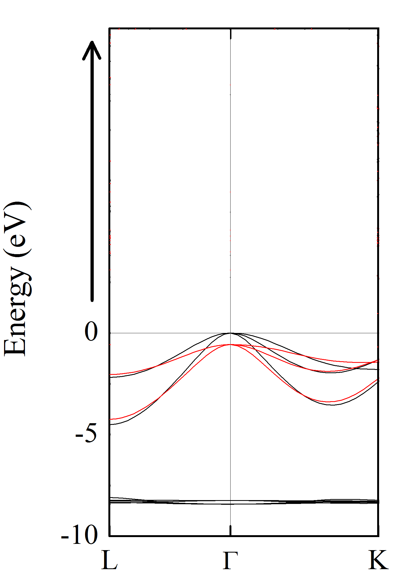
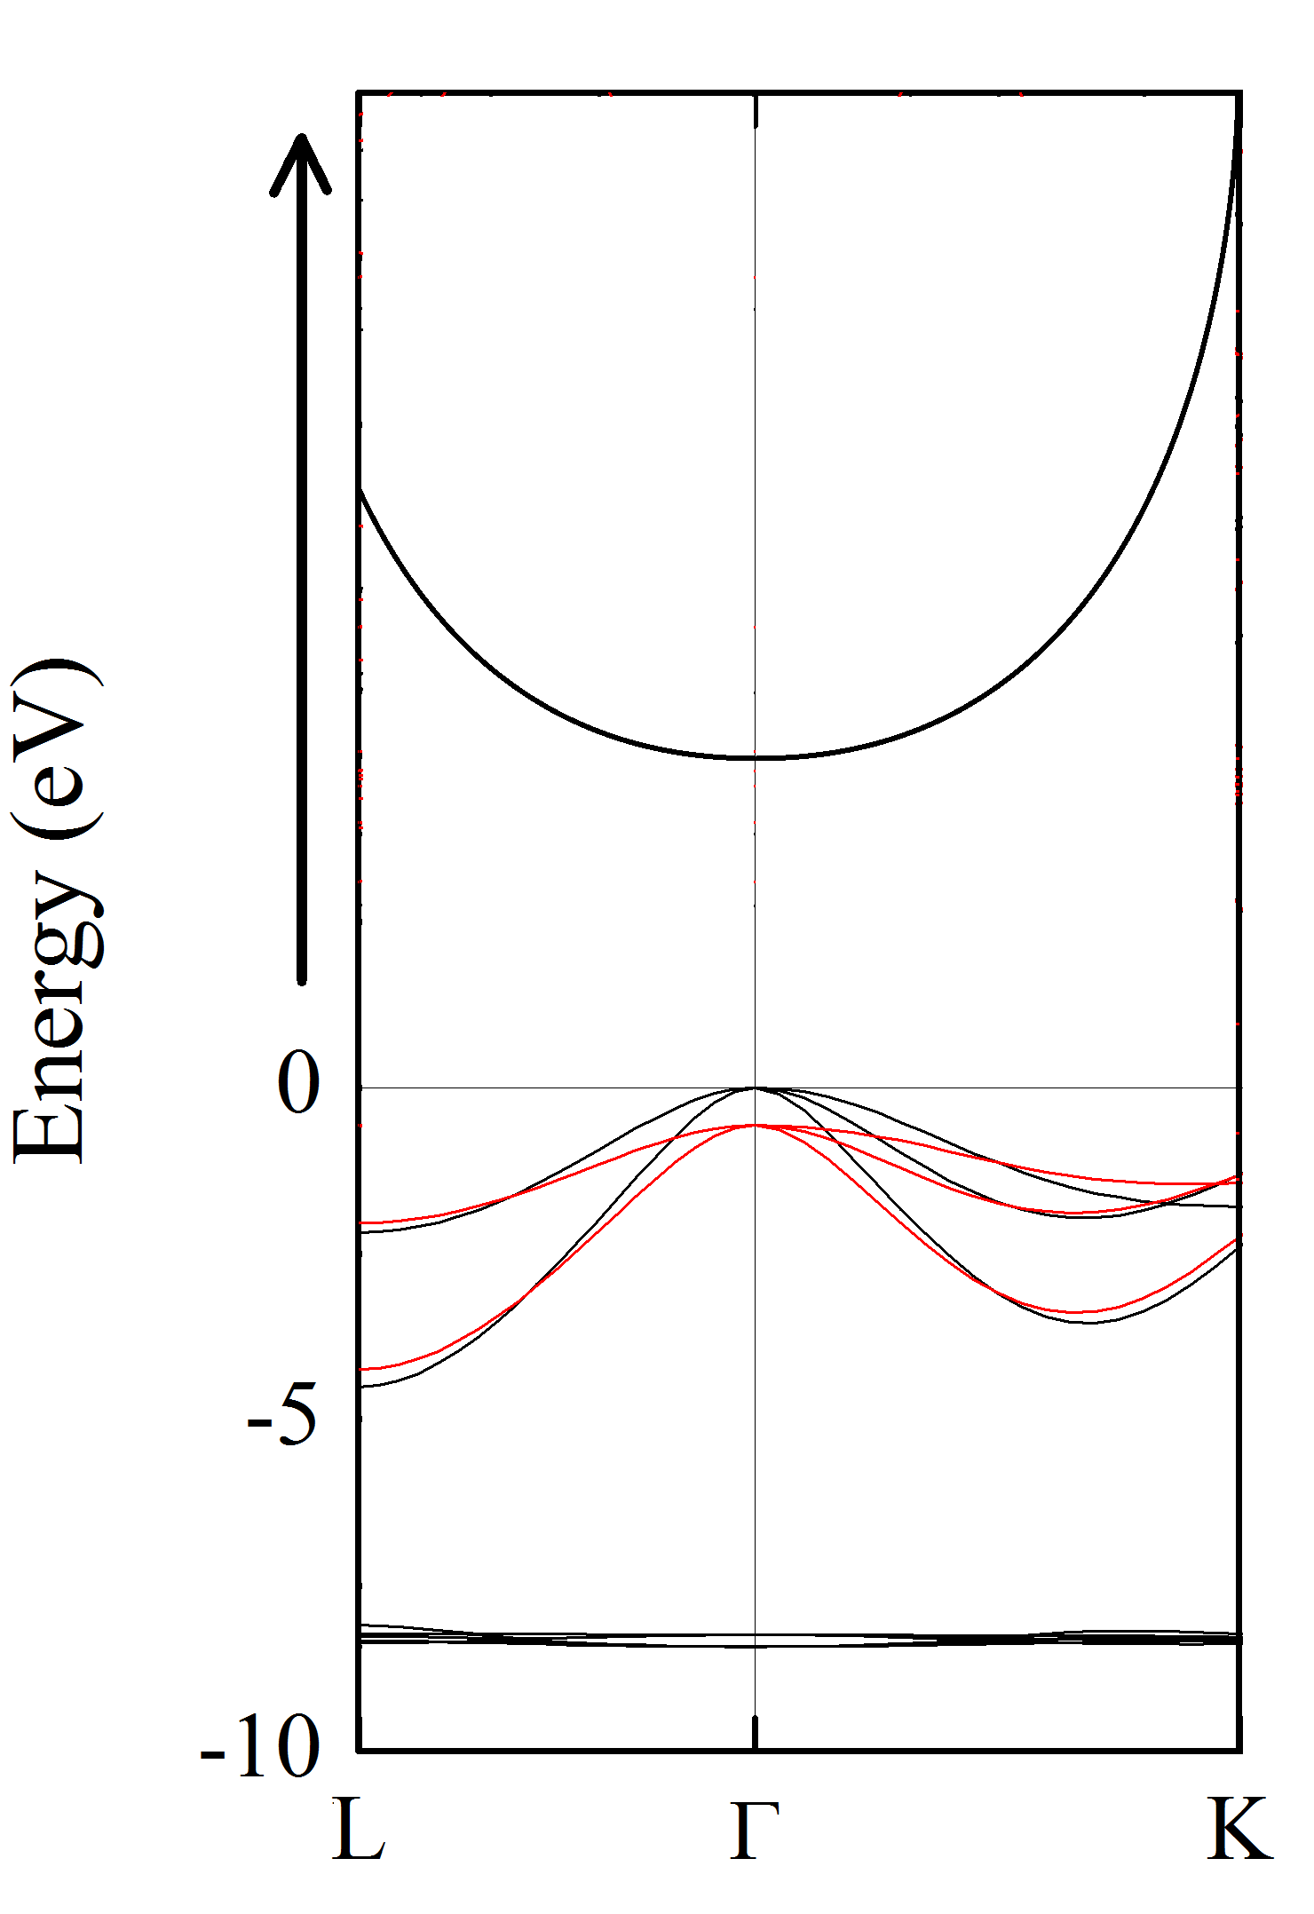
GdN

Slide 5
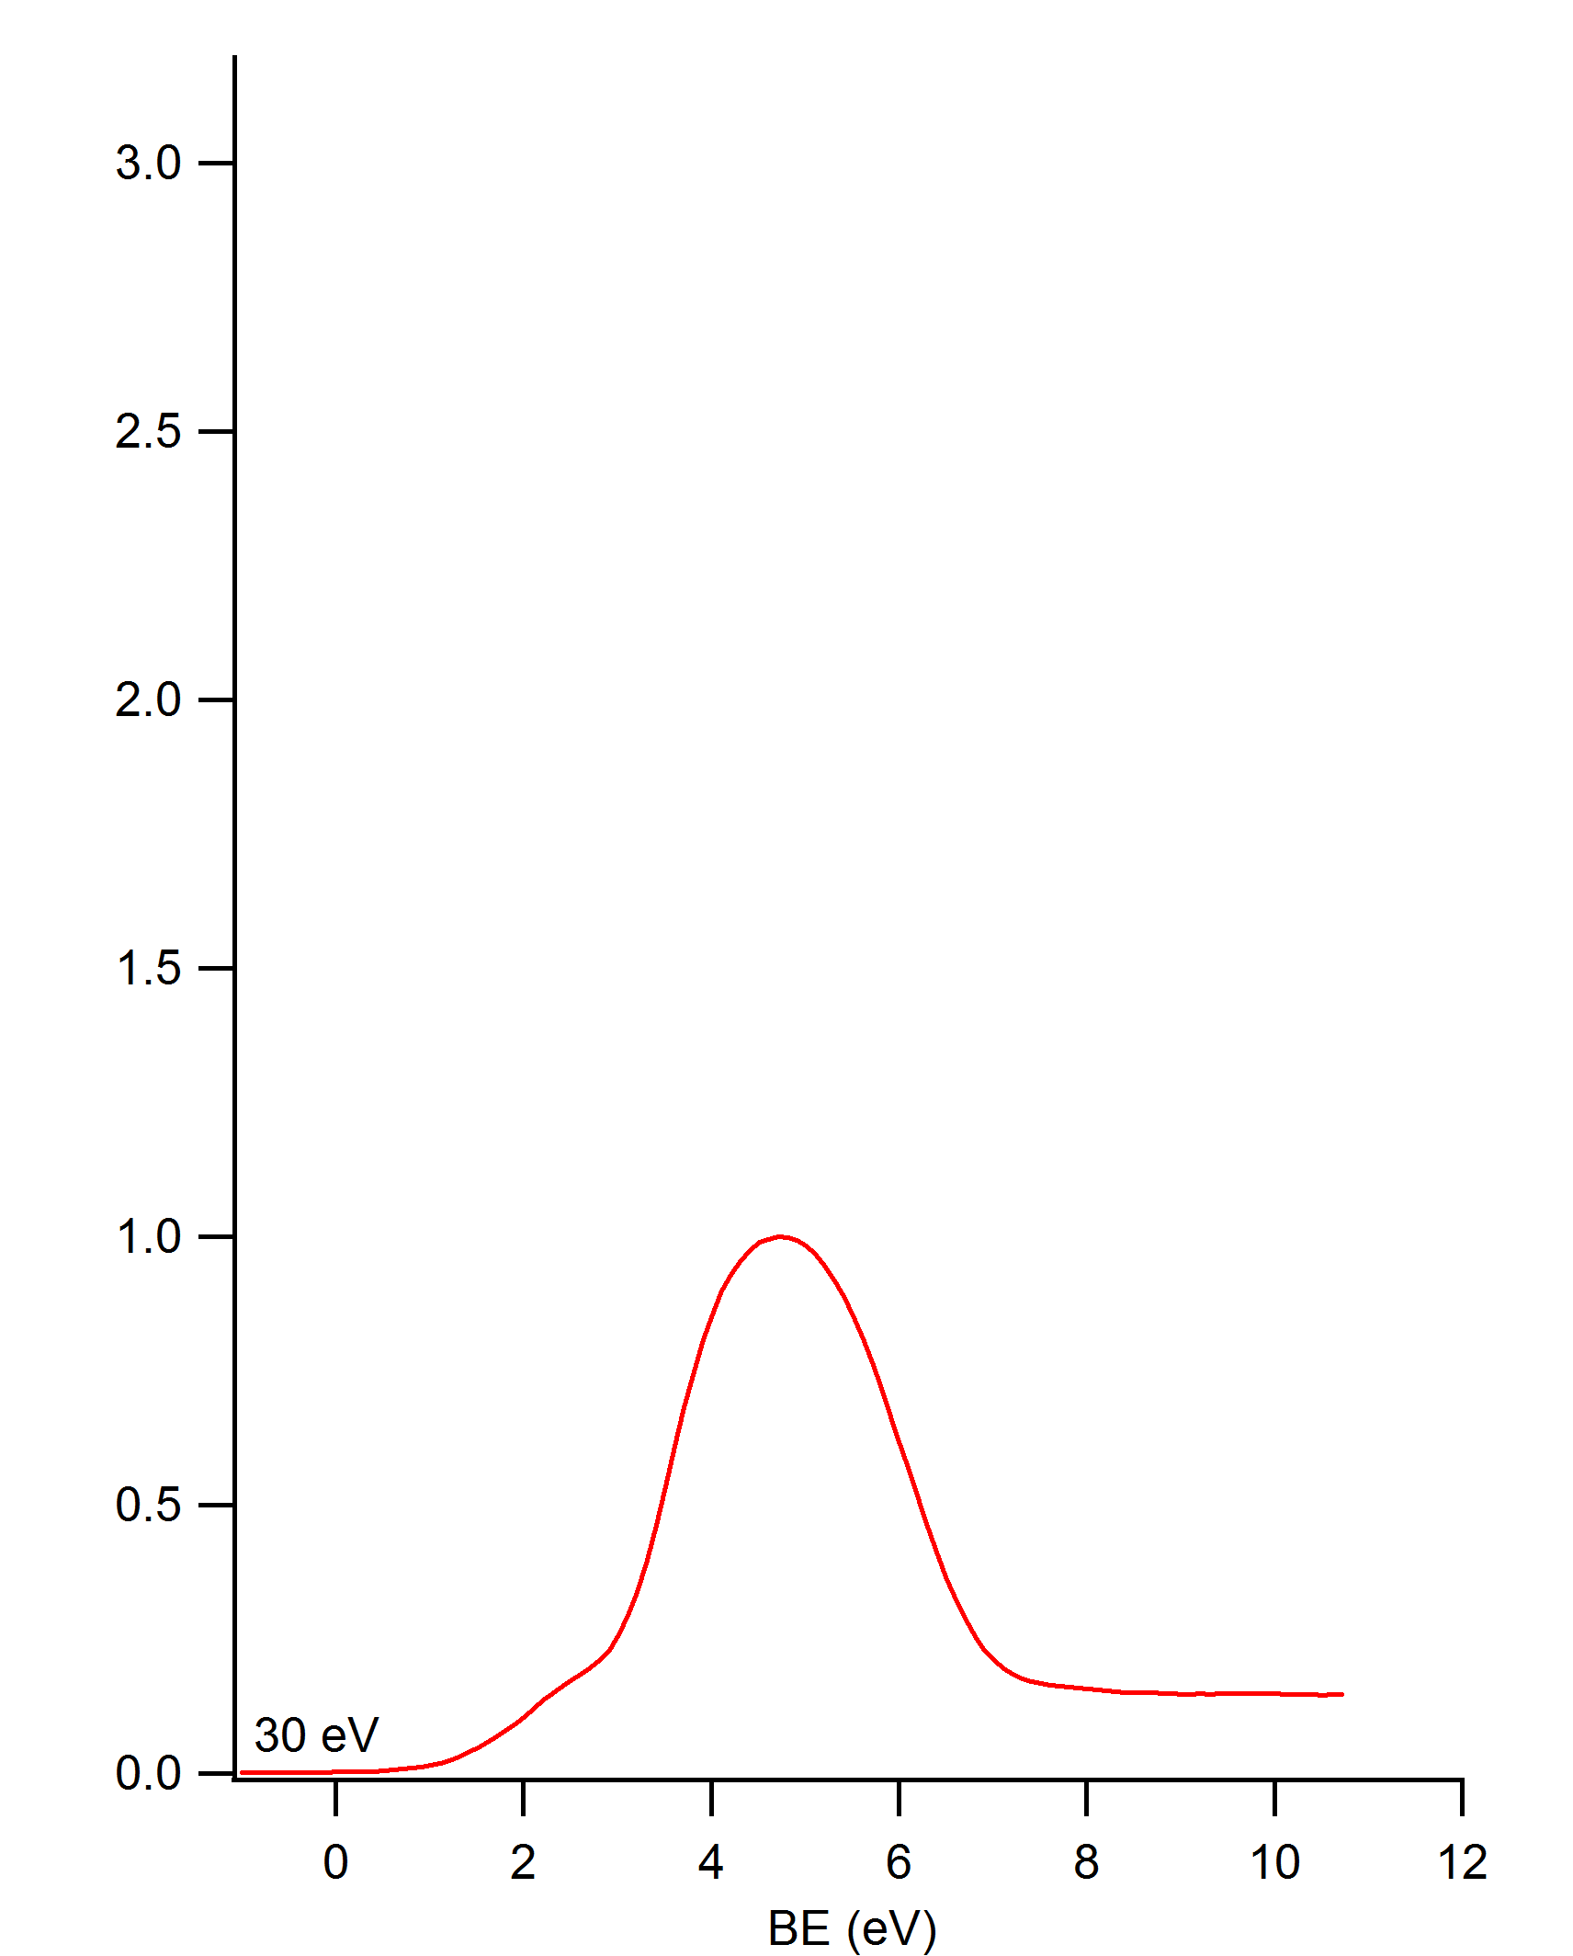
GdN

Slide 6
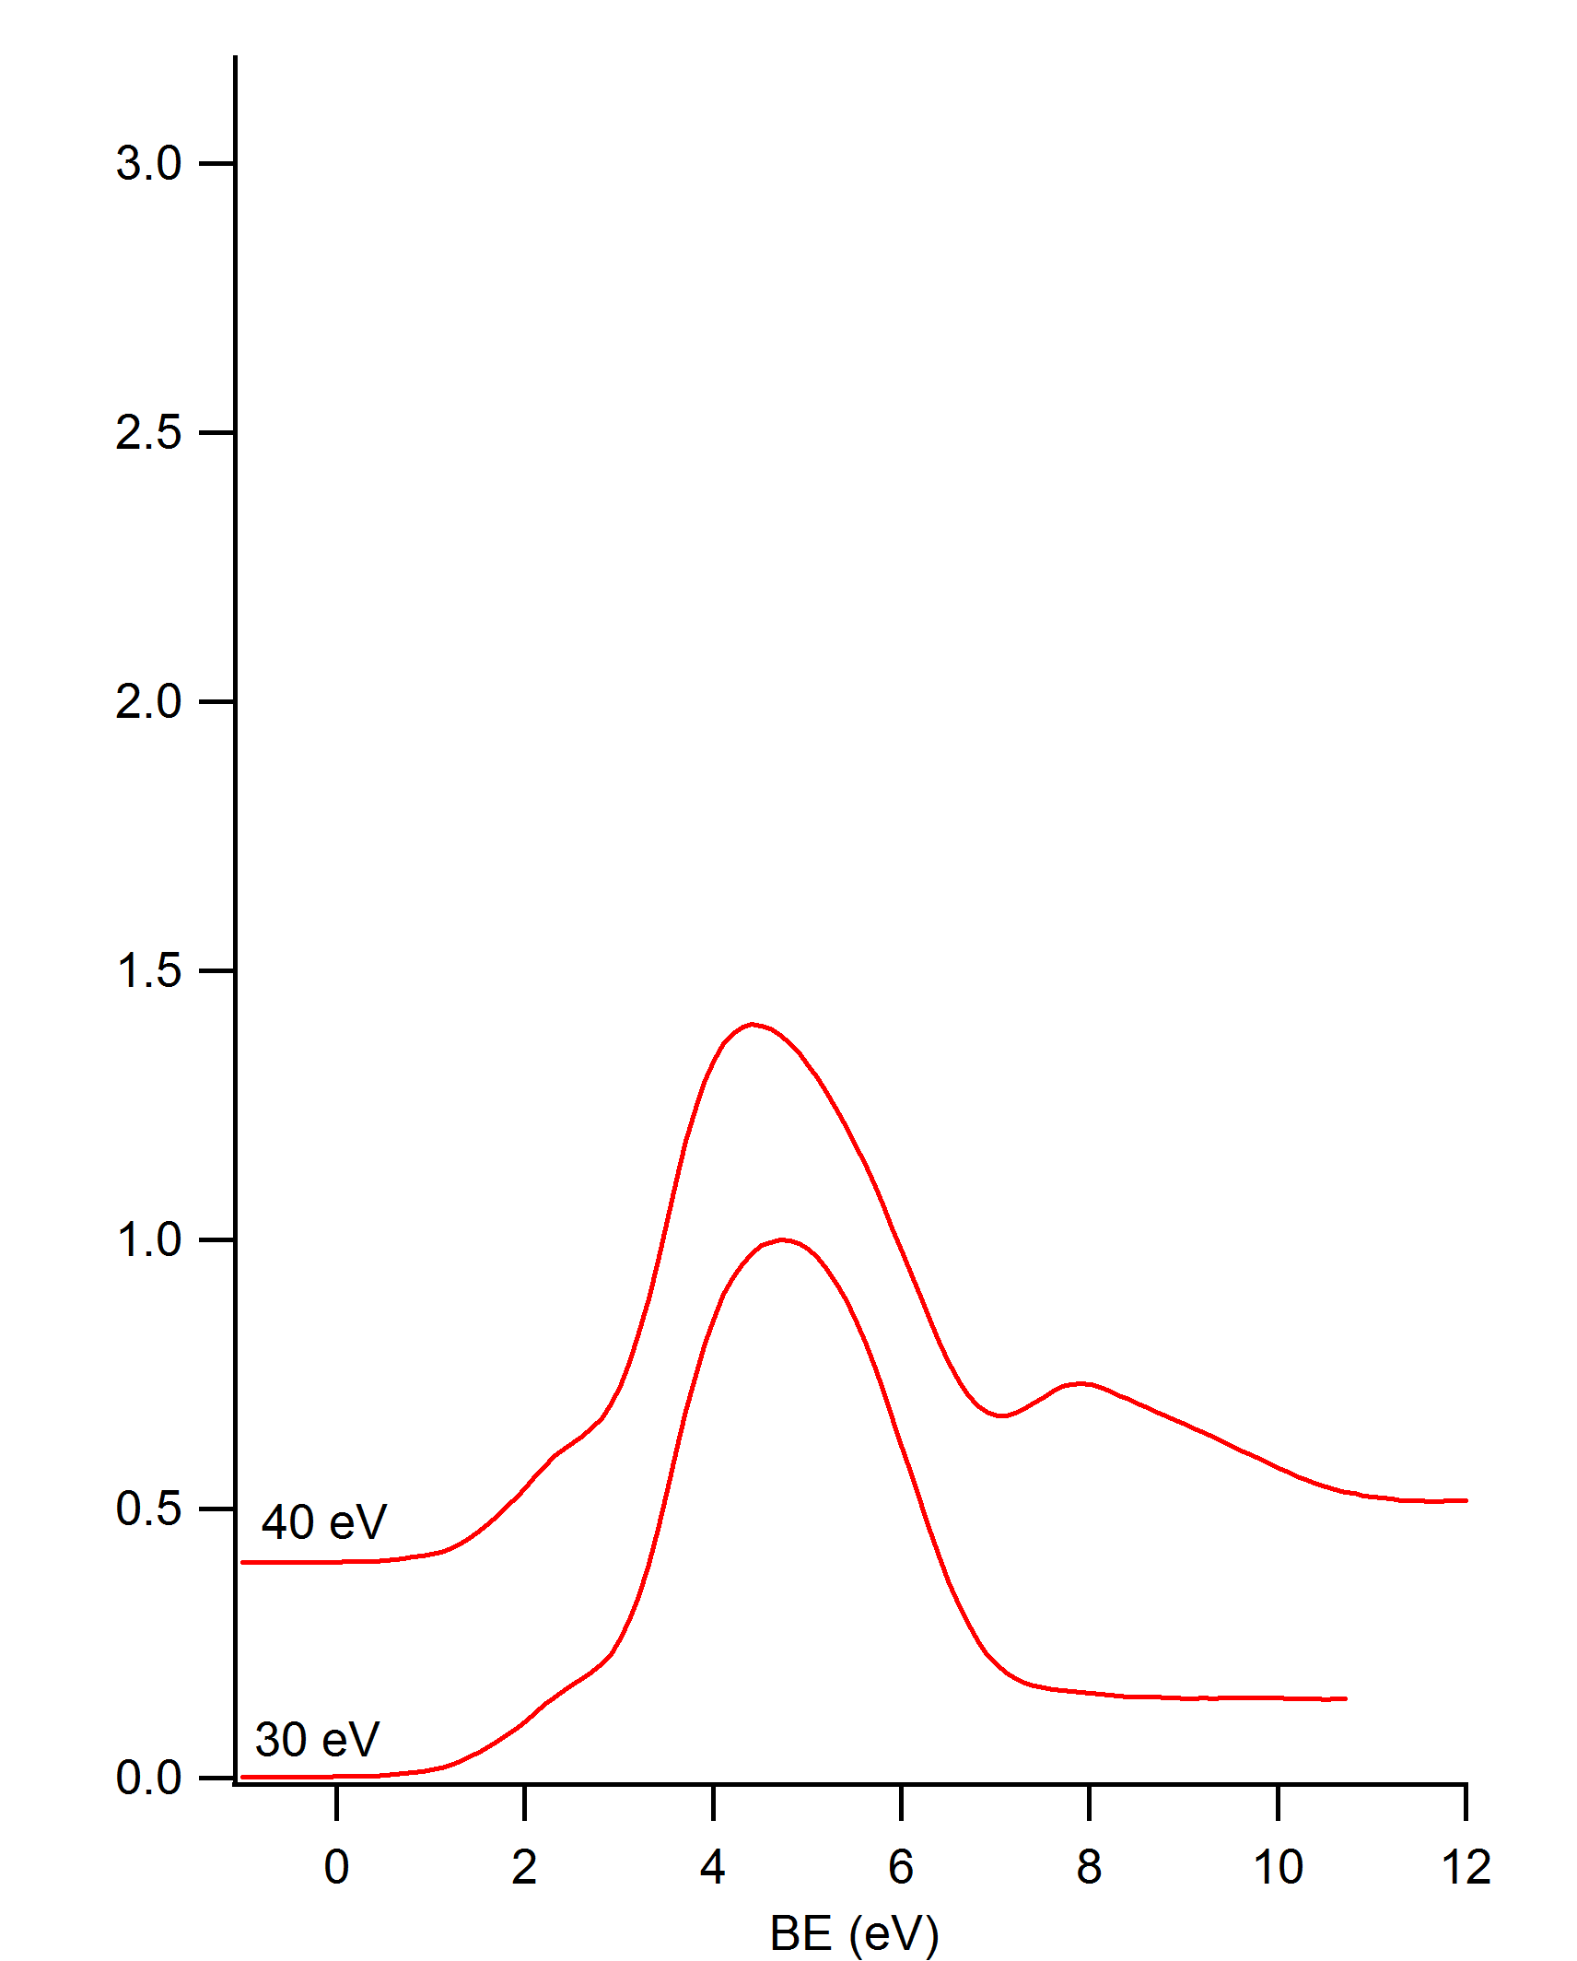
GdN

Slide 7
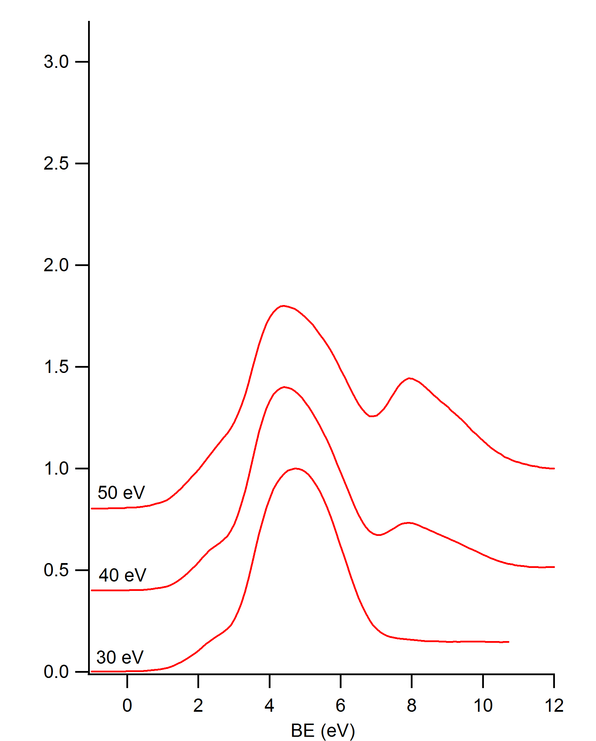
GdN

Slide 8
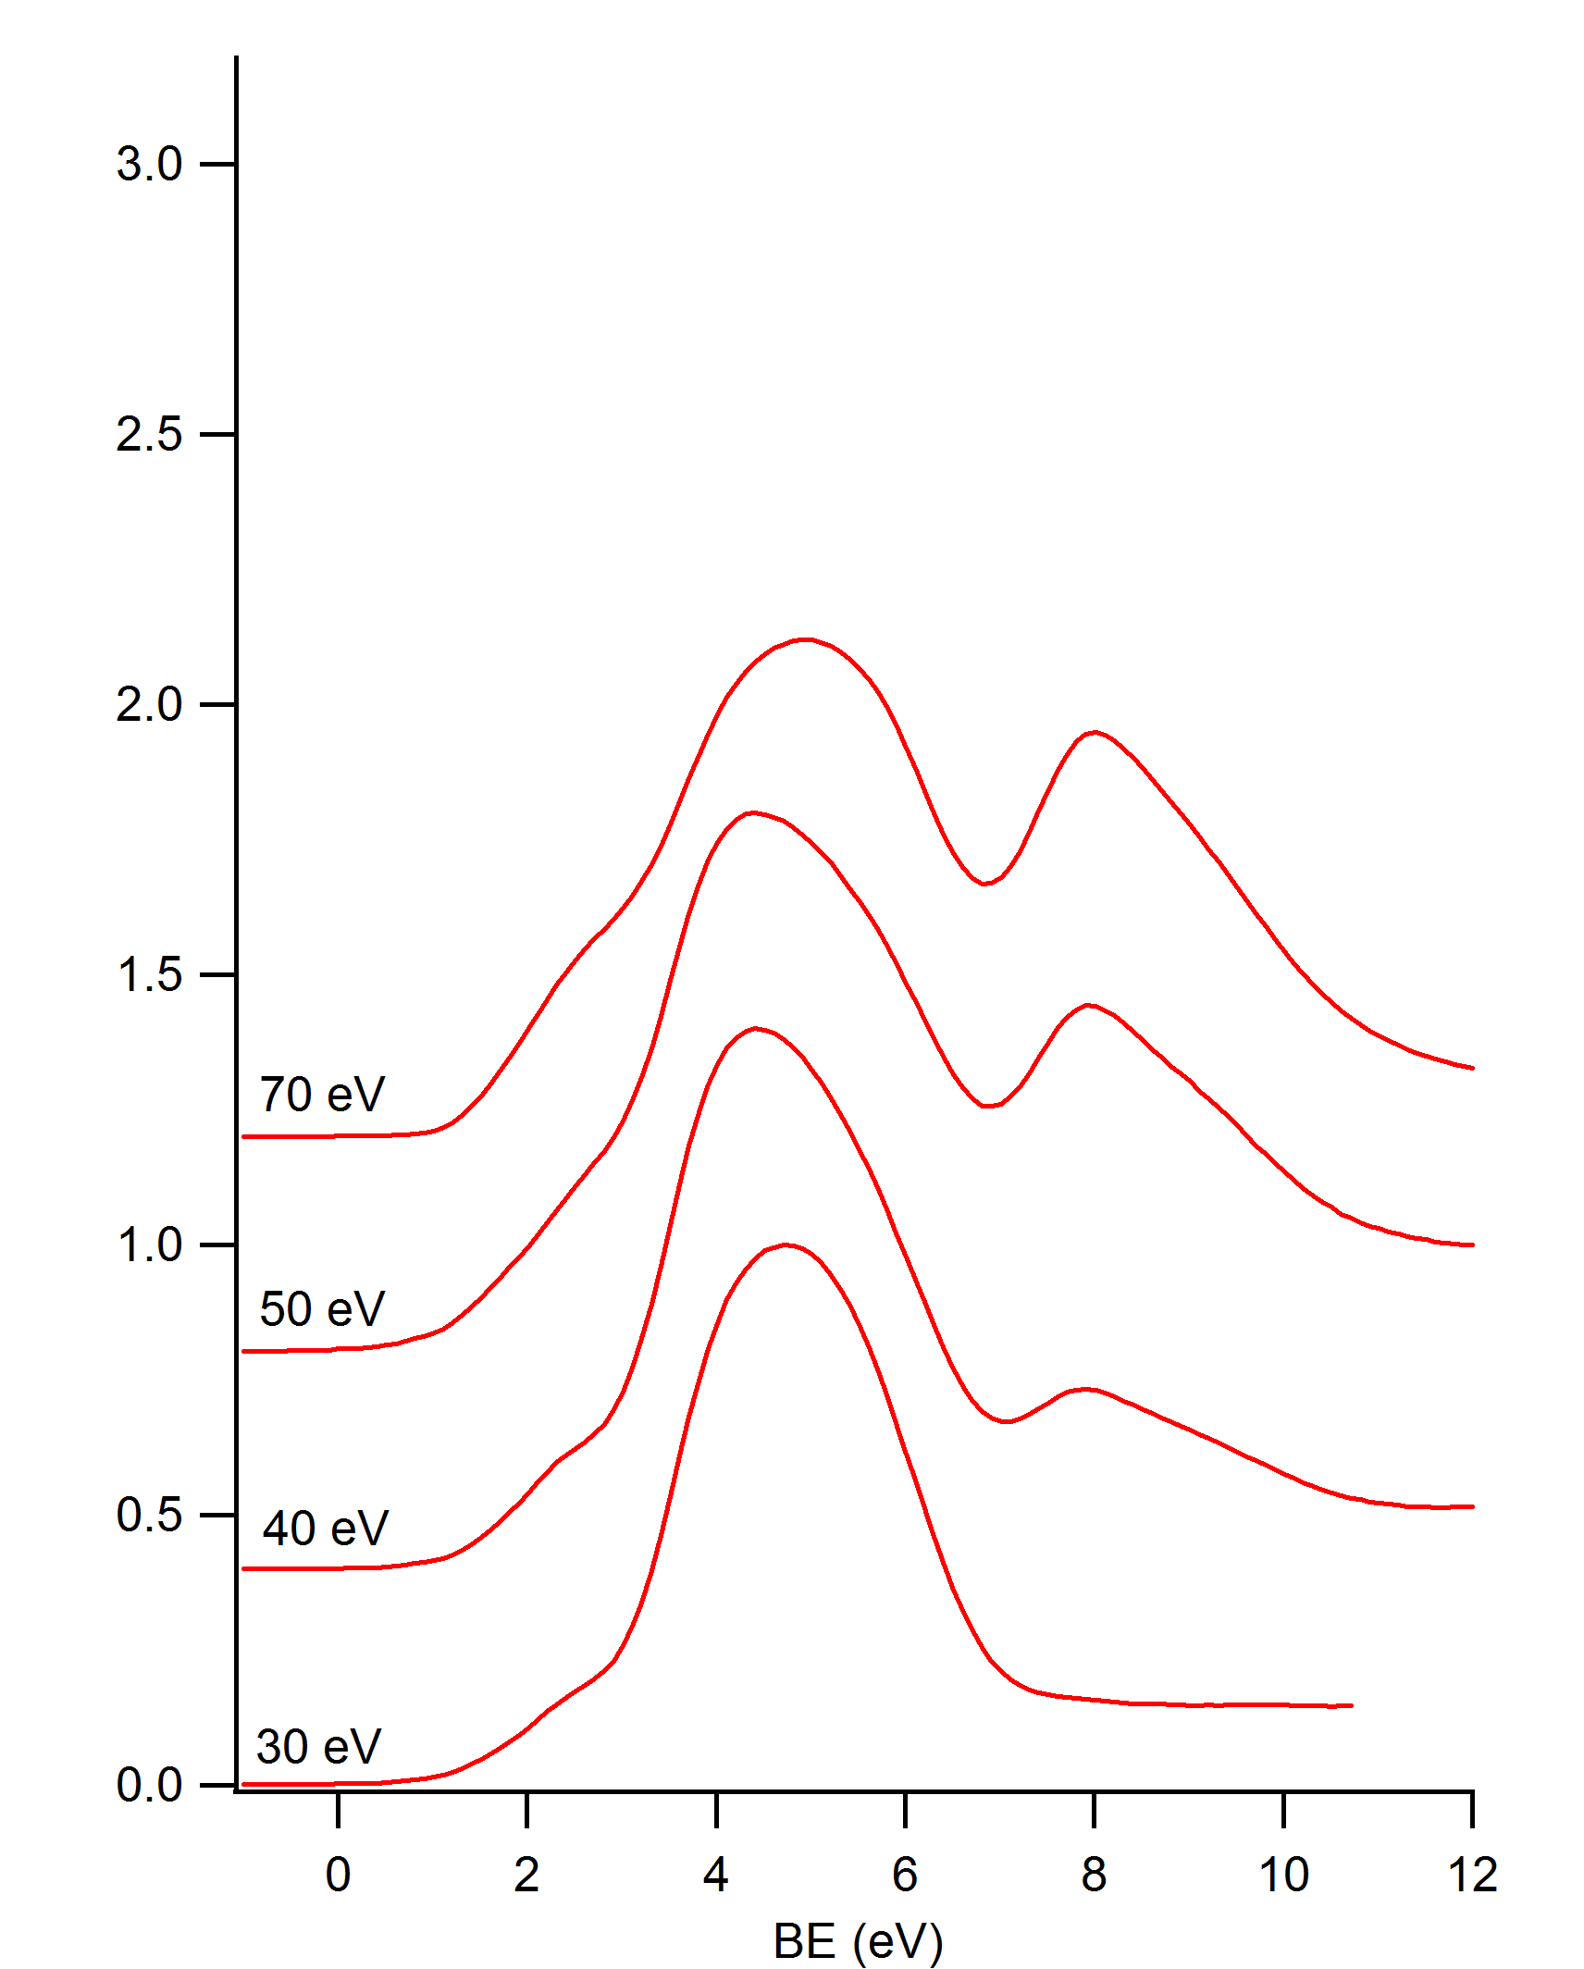
GdN

Slide 9
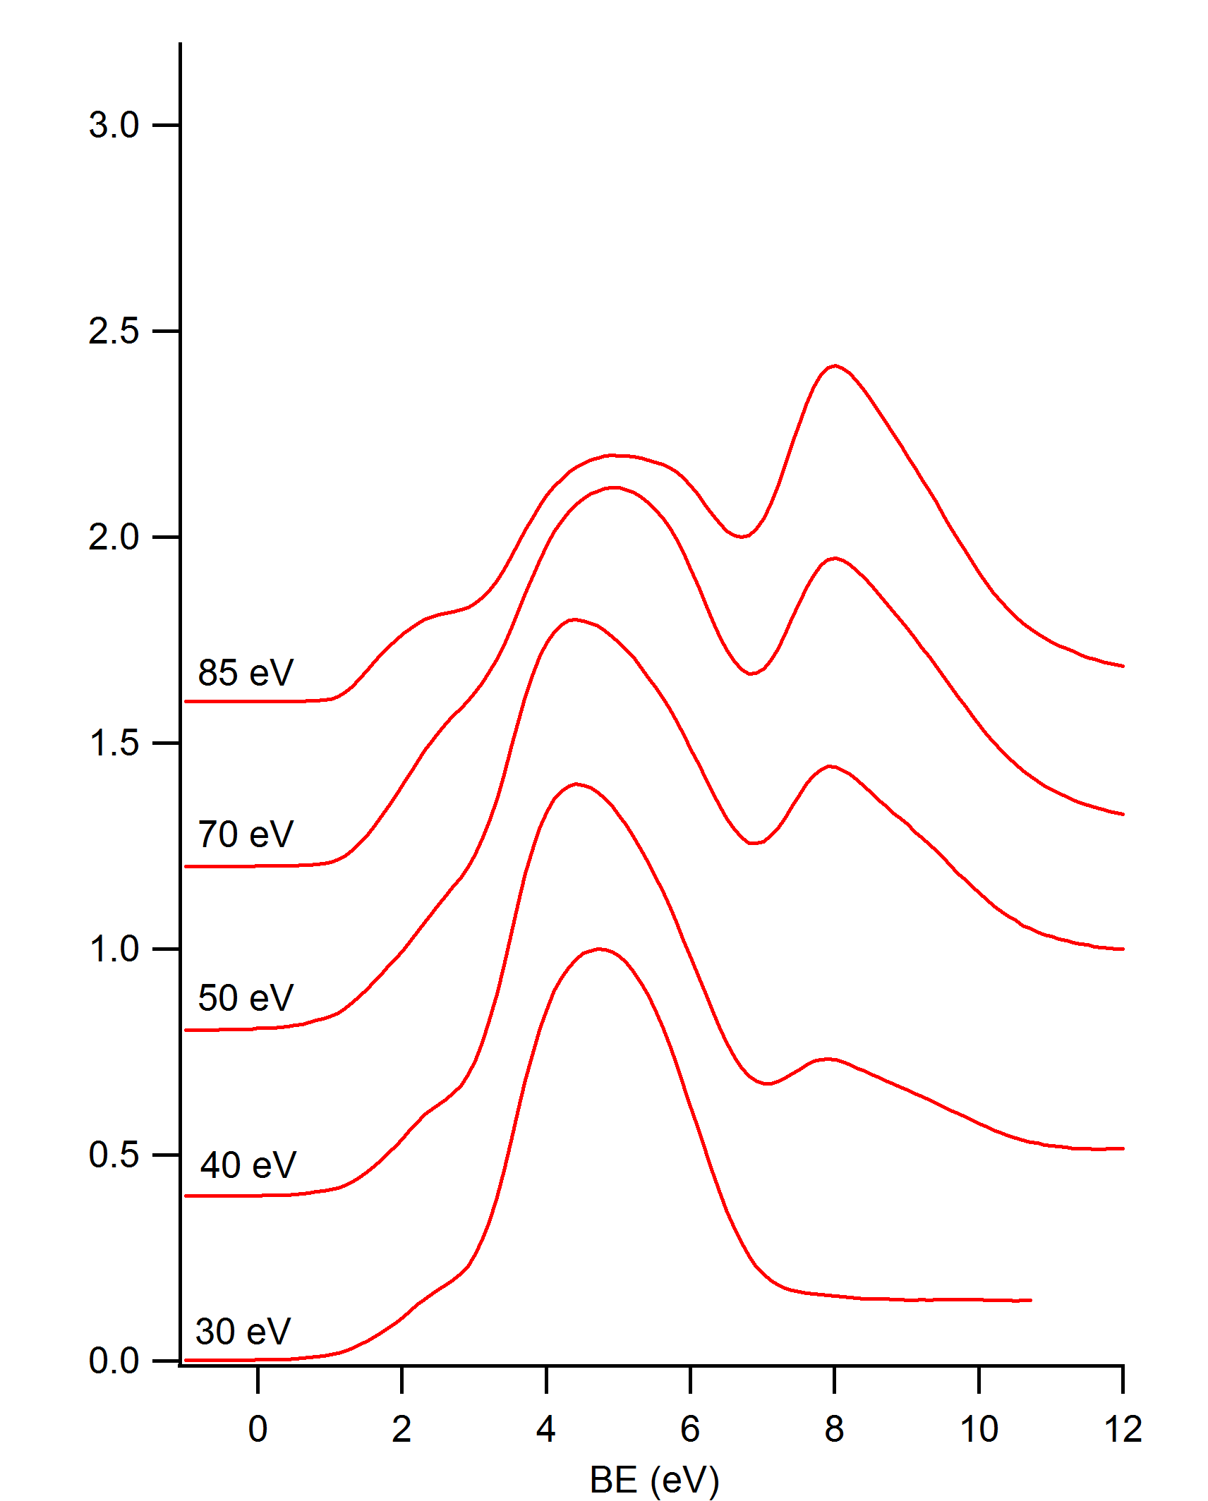
GdN

Slide 10
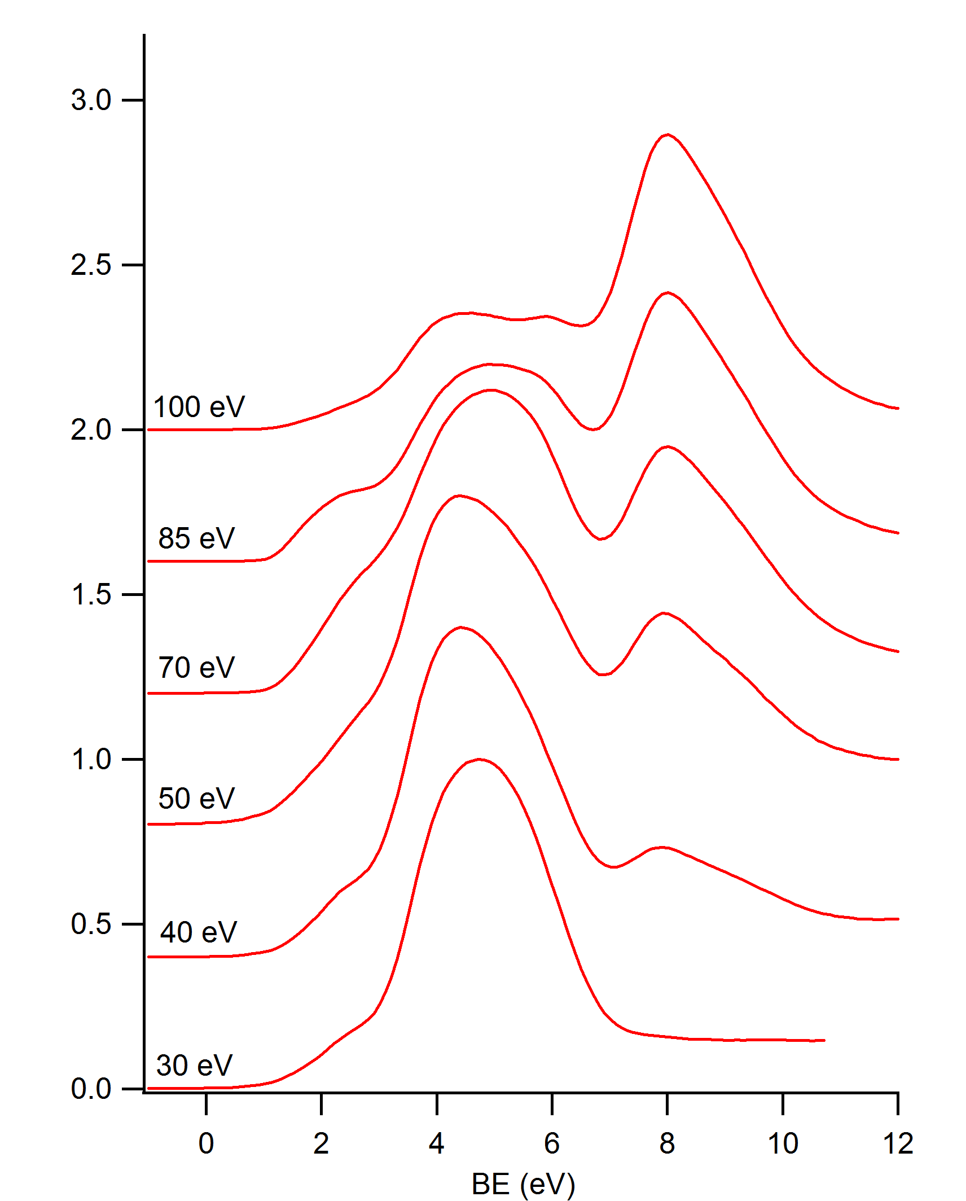
GdN

Slide 11
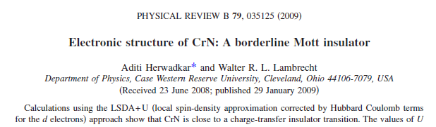
CrN theory

Slide 12
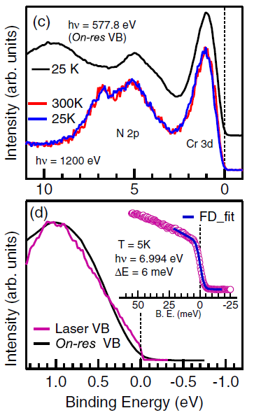
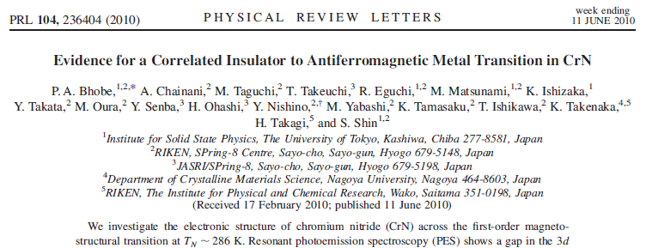
CrN experiment

Slide 13
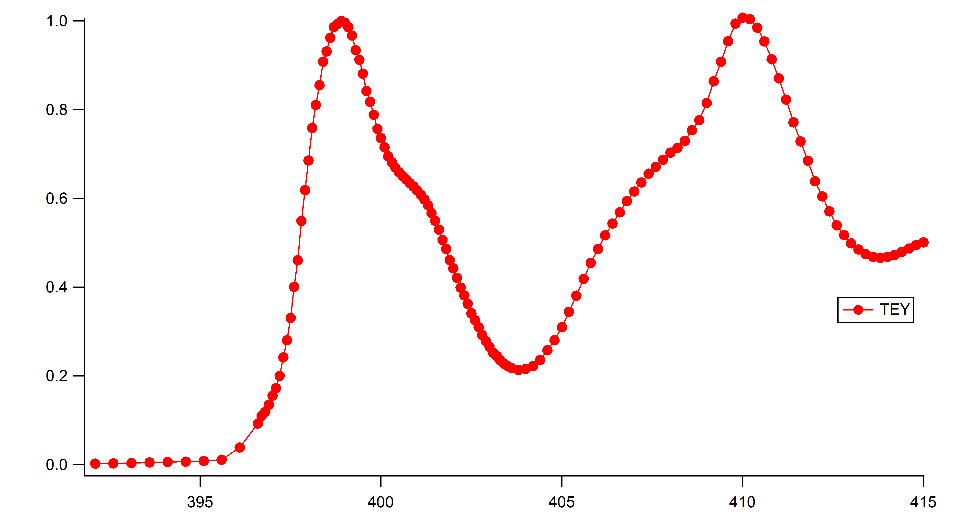
CrN XAS

Slide 14
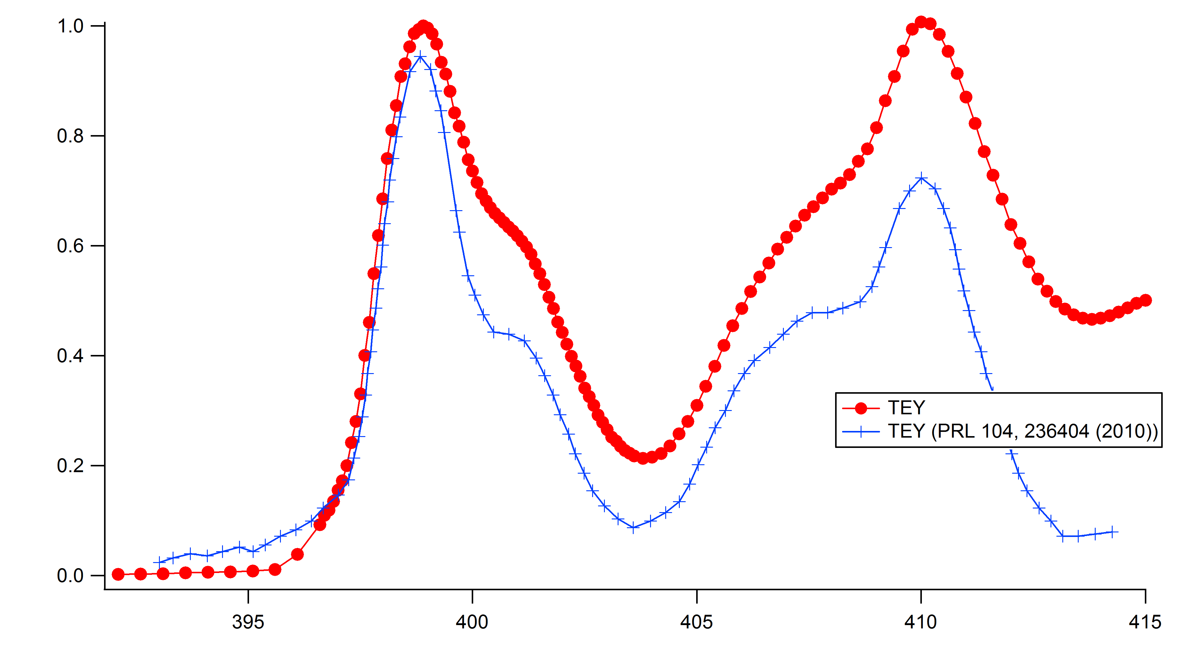
CrN XAS

Slide 15
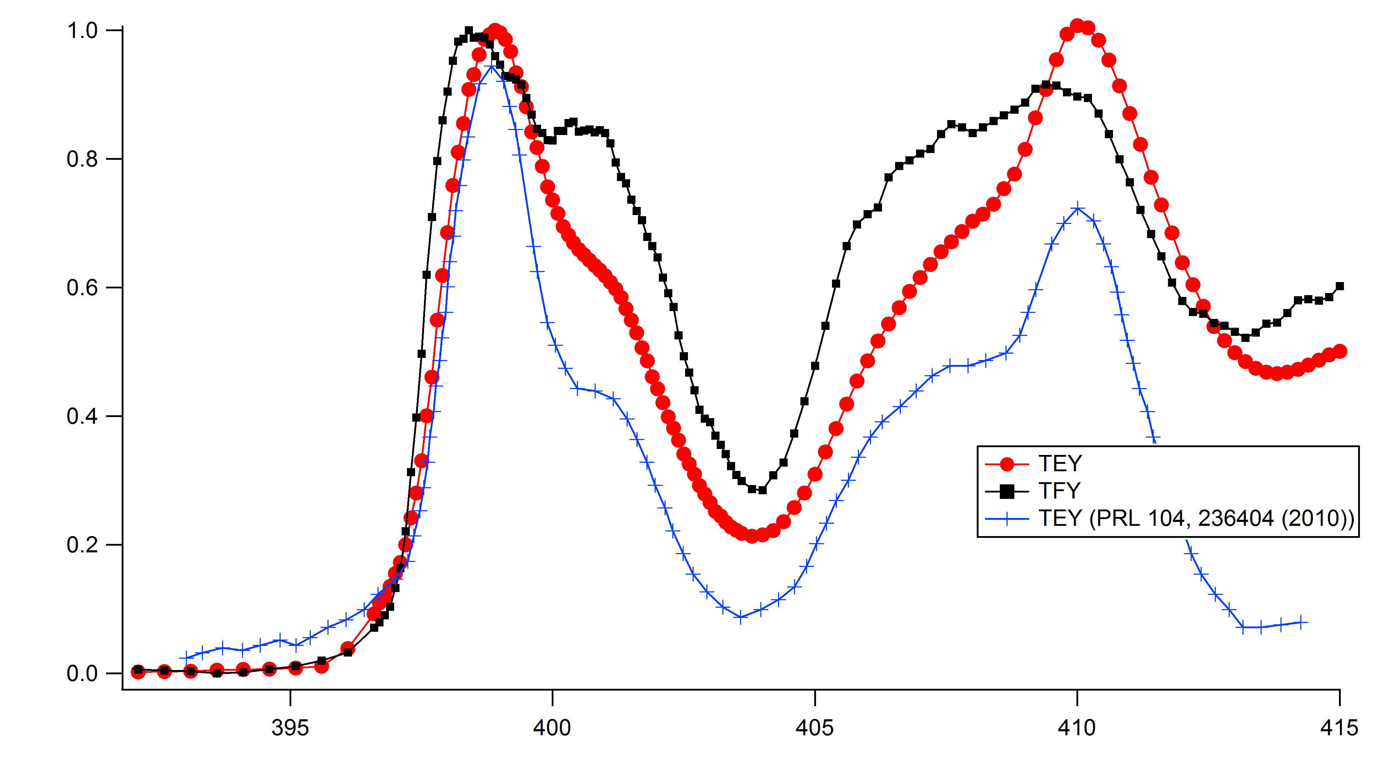
CrN XAS

Slide 16
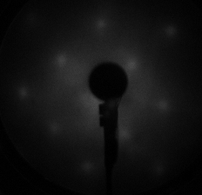
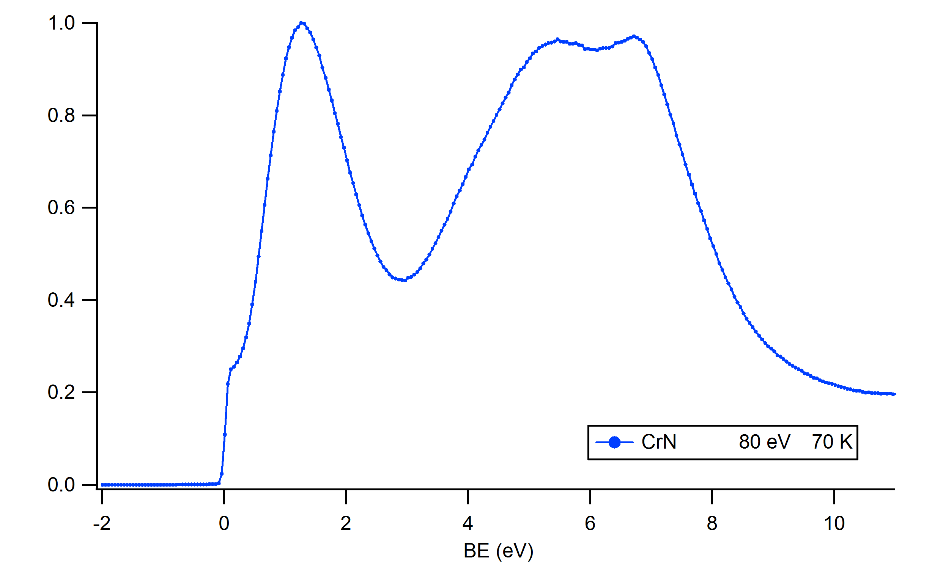
CrN XPS

Slide 17
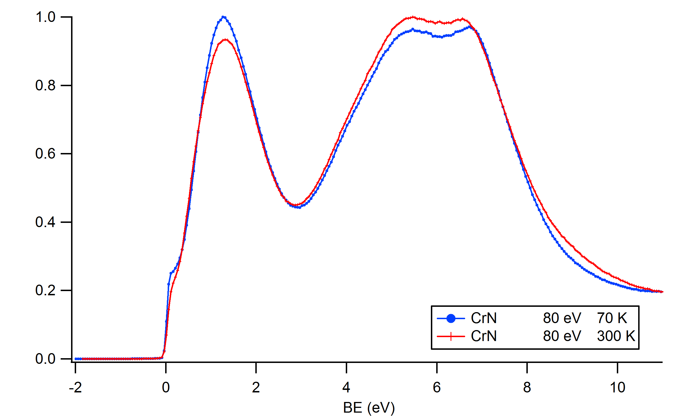
CrN XPS

Slide 18
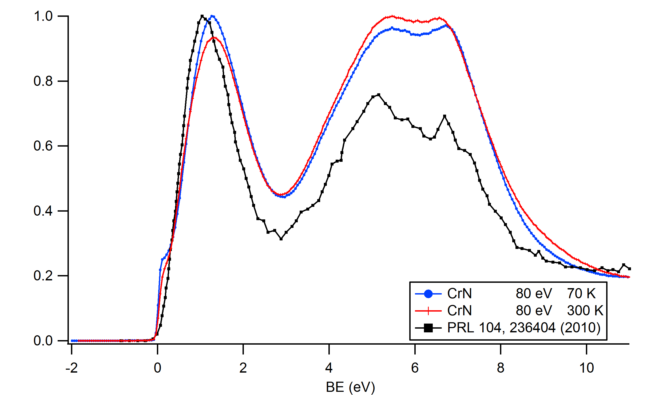
CrN XPS

Slide 19
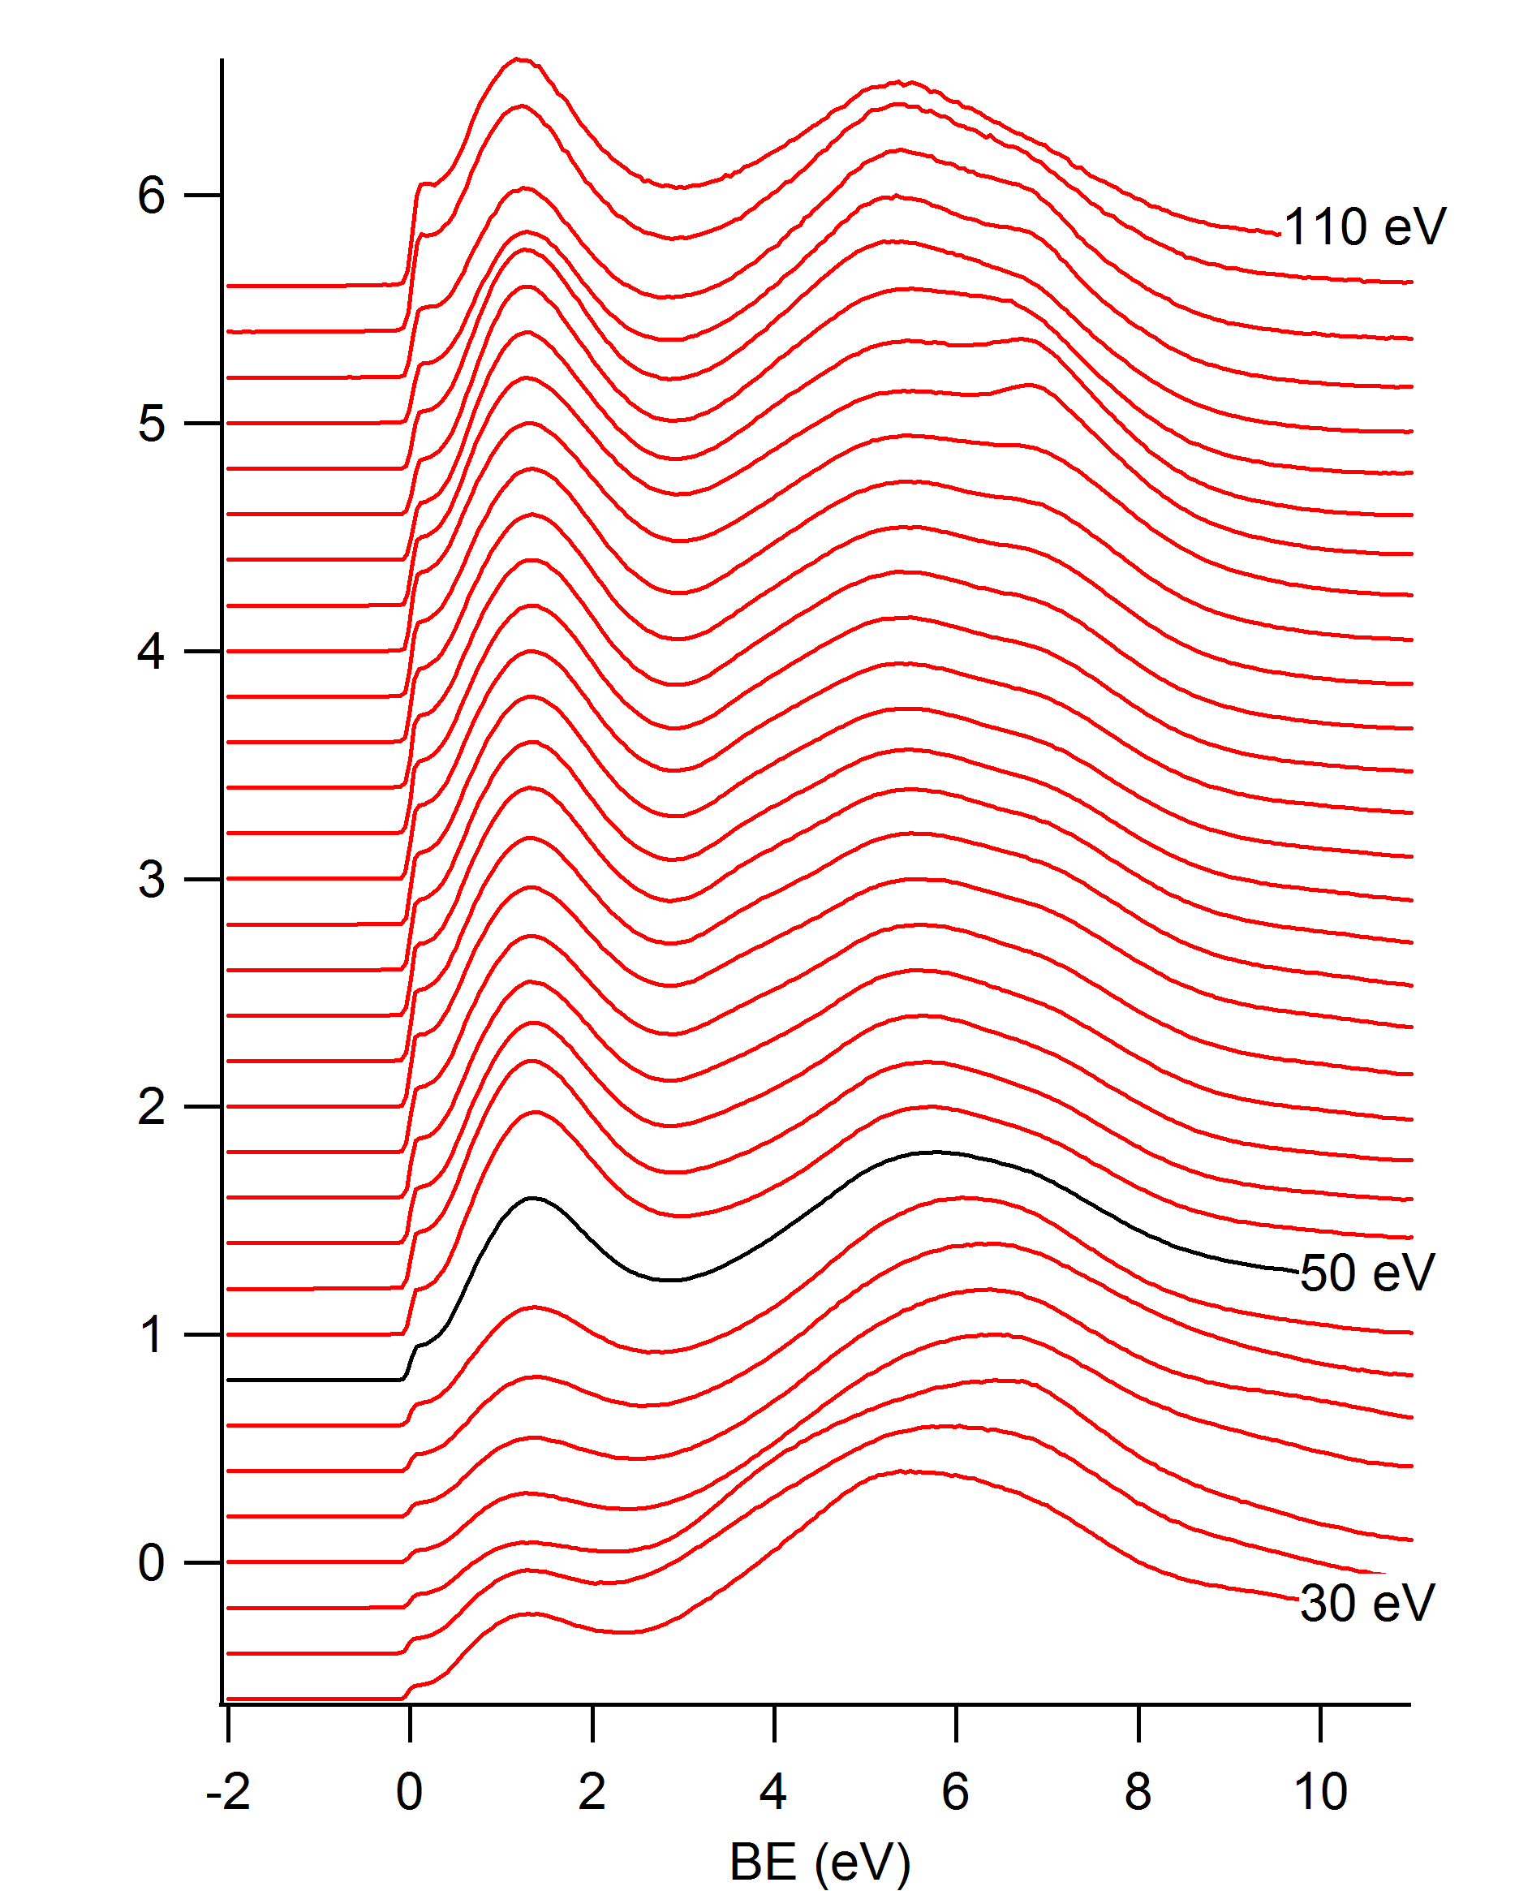
CrN XPS

Slide 20
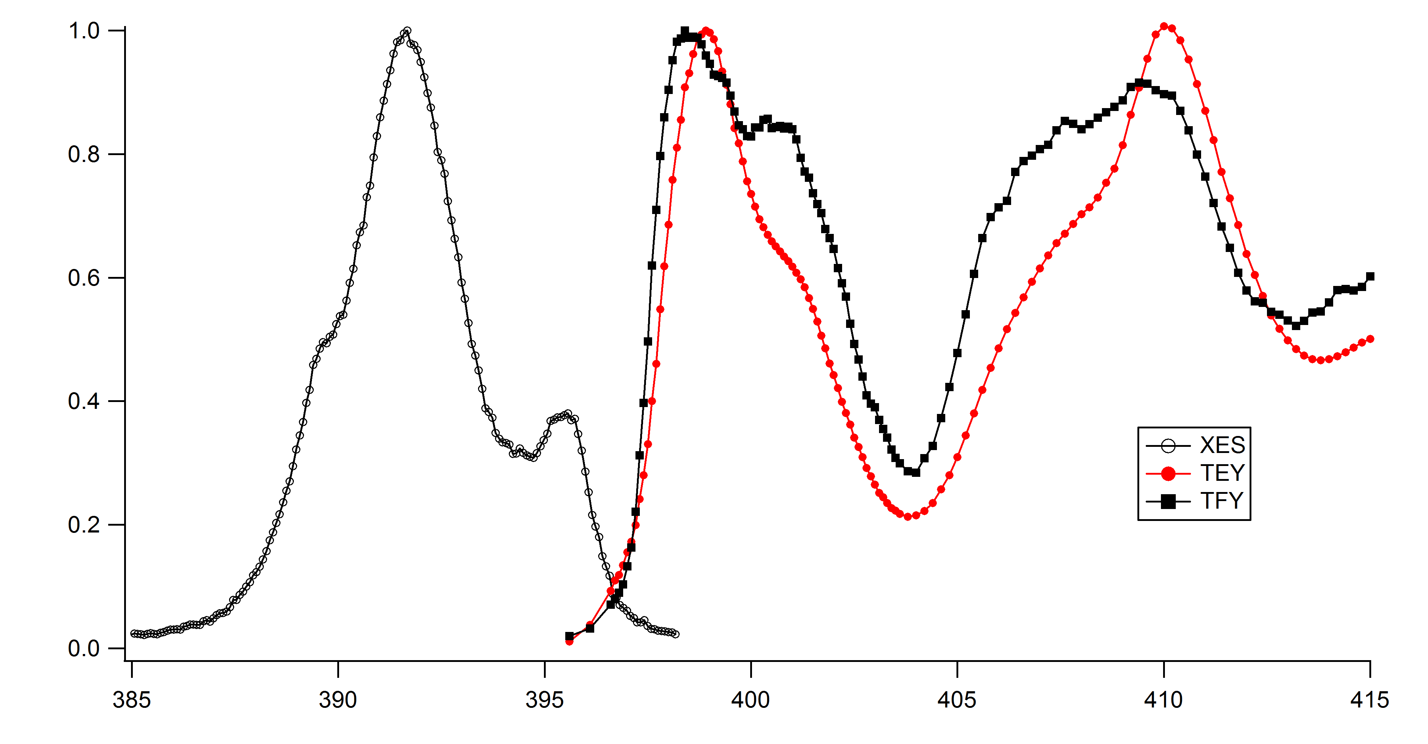
CrN XXS

Slide 21
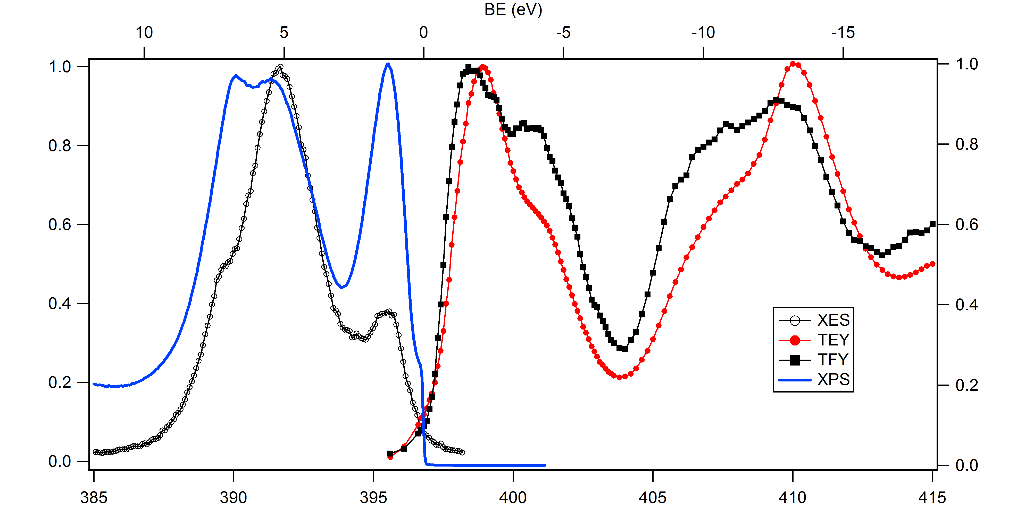
CrN XXS

Slide 22
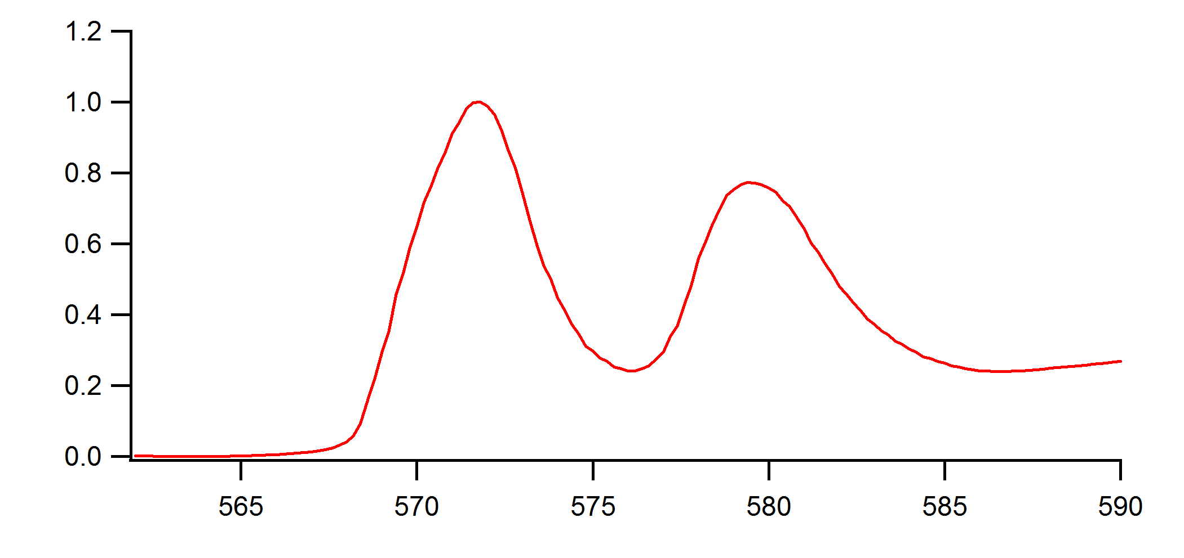
CrN RPES

Slide 23
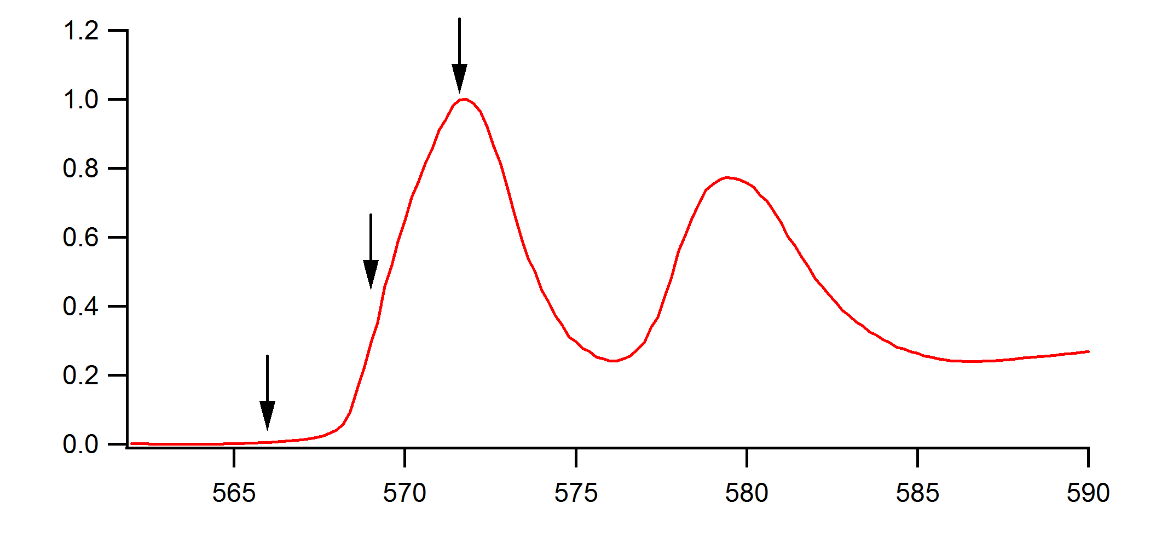
CrN RPES

Slide 24
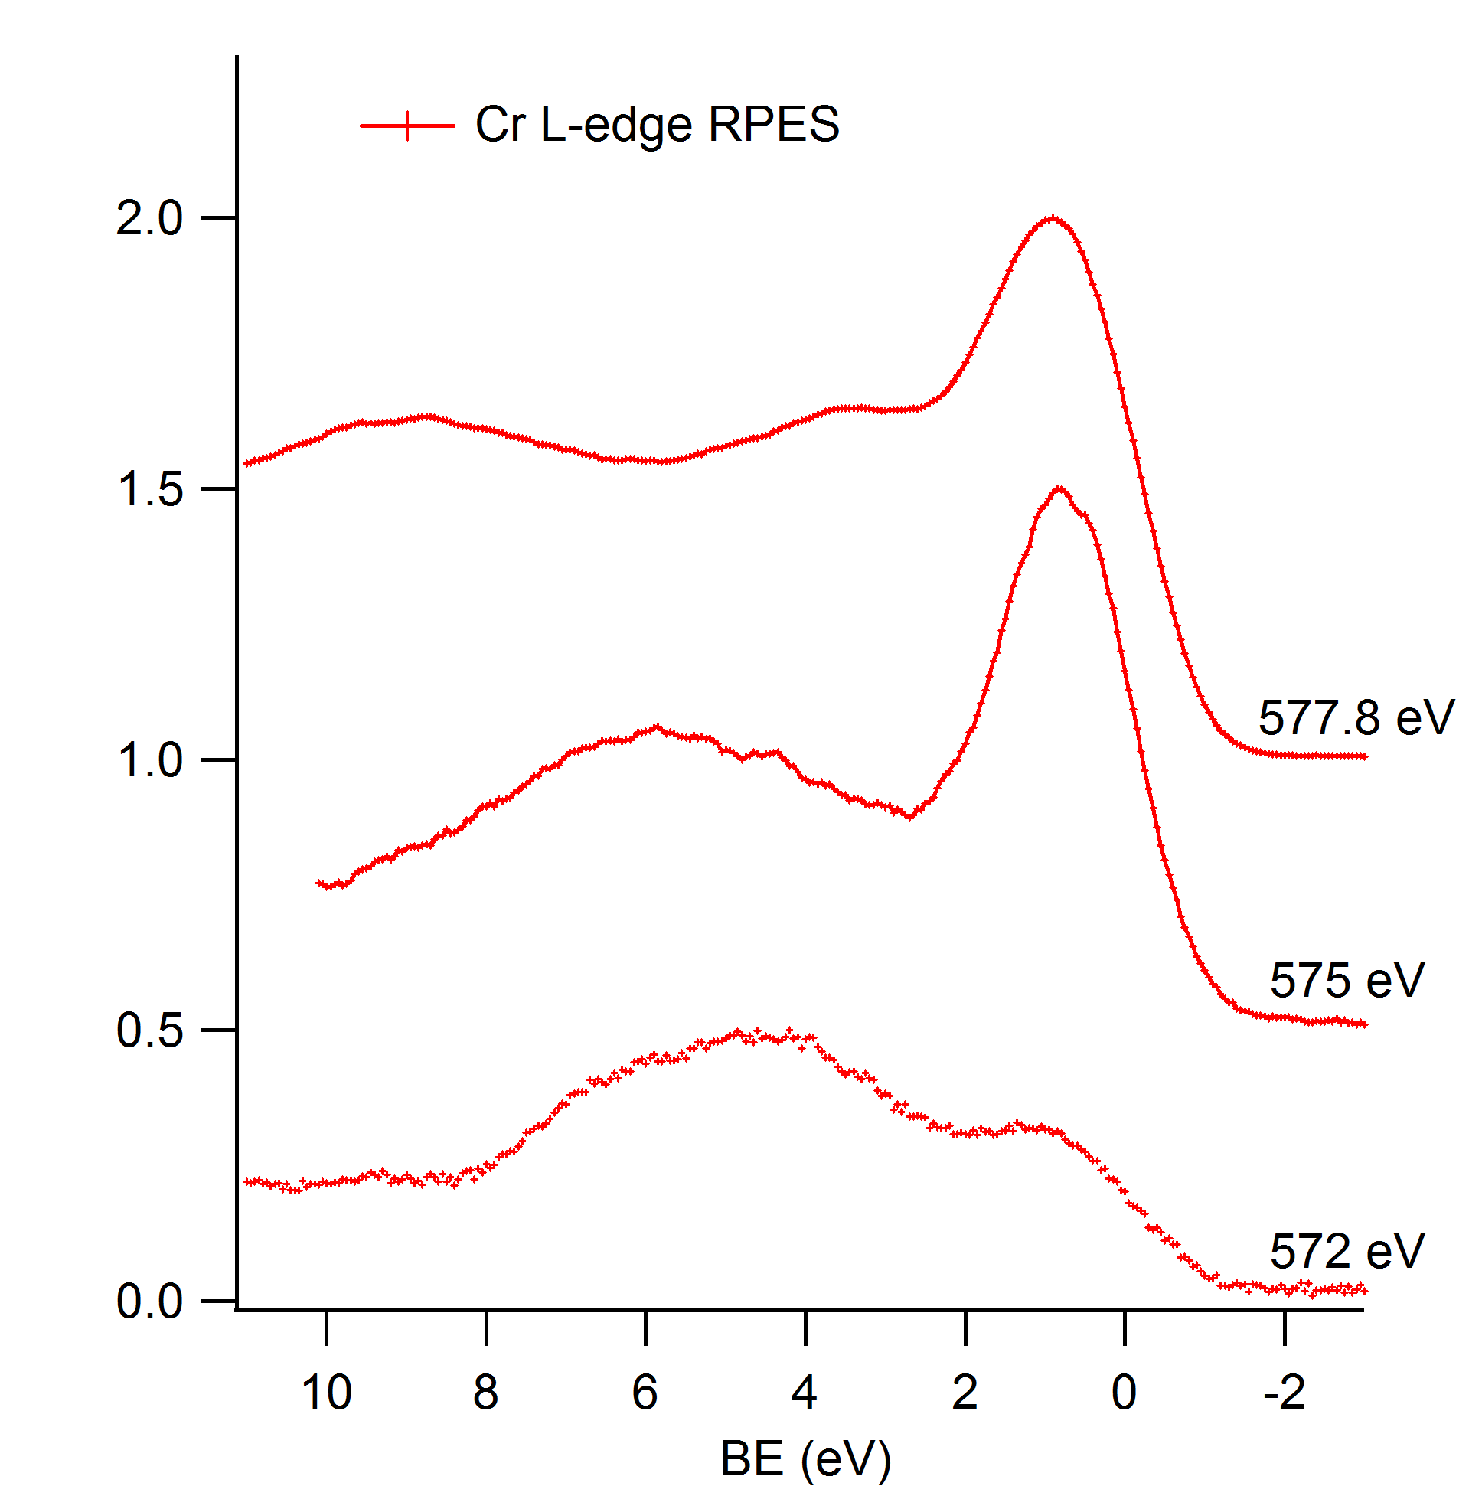
CrN RPES

Slide 25
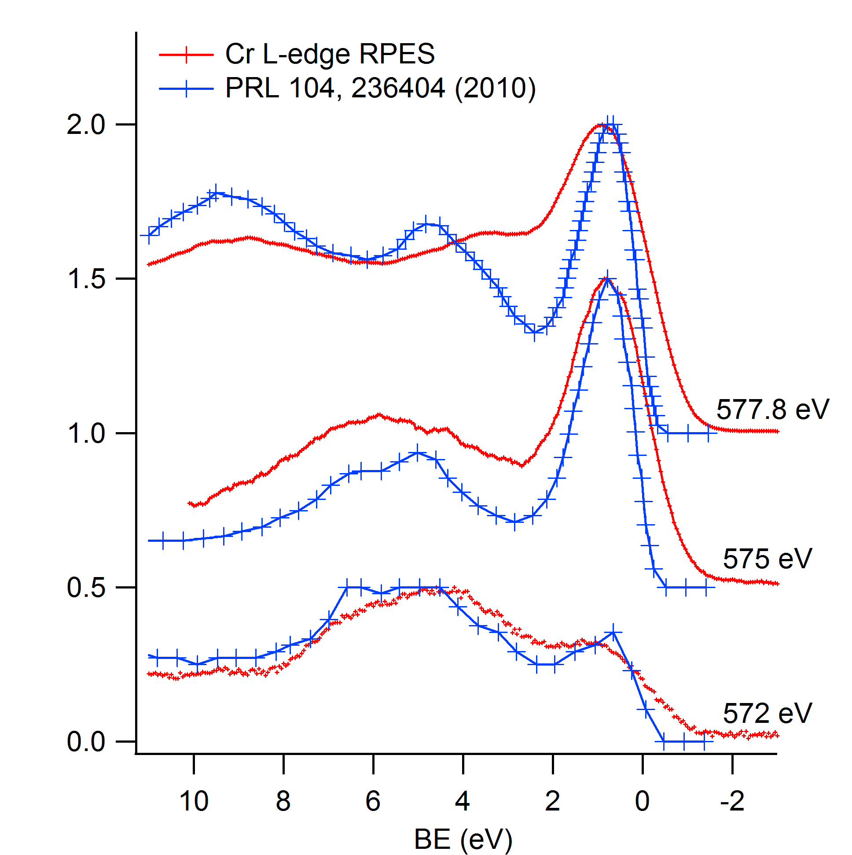
CrN RPES

